Slide 1
Downtown Parking
Discussion
Faculty Senate Meeting
December 4, 2012

Slide 2
Parking Wisdom
“When Solomon said there was a time and a place for everything he had not encountered the problem of parking his automobile.”
Bob Edwards
“Politics ain’t worrying this country one-tenth as much as where to find a parking space.”
Will Rogers
“Anyplace worth its salt has a ‘parking problem.’”
James Castle

Slide 3
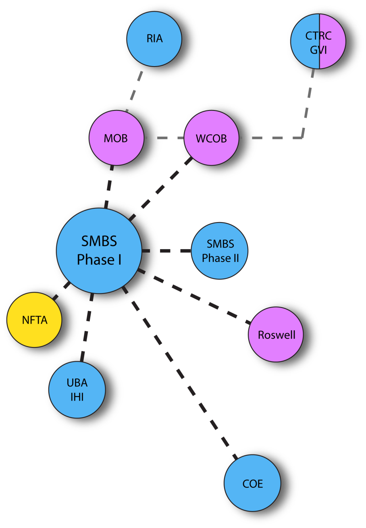
Medical School Site and Benefits
Central Location to:
- Women's & Children's Hospital (WCOB) (planned)
- Medical Office Building (MOB) (planned)
NFTA Metro Rail Station
Existing UB SMBS Facilities
Buffalo General Hospital
Roswell Park (RPCI)
Link and create a coatless connection between MOB, SMBS, NFTA, Buffalo General, RPCI, CTRC, RIA etc.
Fast and efficient connection of SMBS to other Health Science Schools on South Campus through Metro Rail.
Begin implementation of a regional Academic Health Center

Slide 4
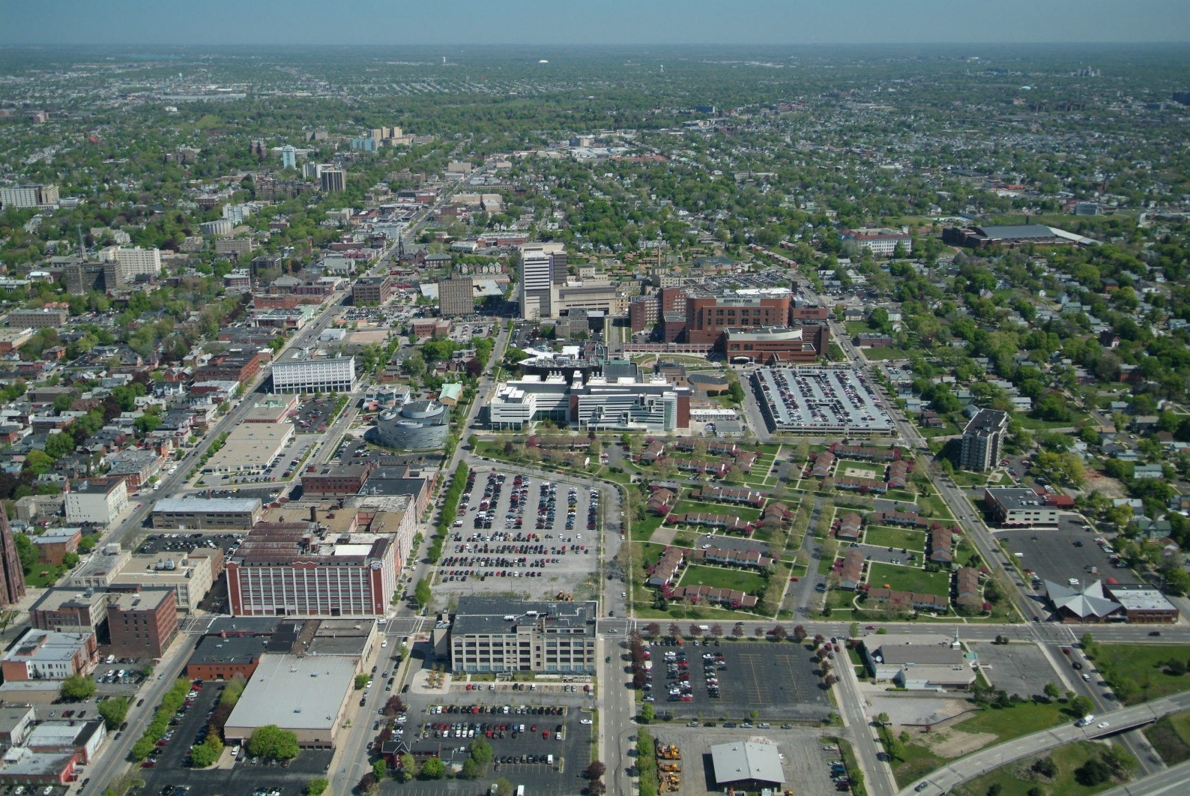
Community Connections
UB
NORTH
UB
SOUTH
NFTA
NFTA
MAIN STREET
BNMC
UB
SMBS
Allentown
NFTA
Fruit Belt
6

Slide 5
BNMC Workforce Trends

Slide 6
Project Schedule
LAND ACQUISITION
March 2012
DESIGN START
May 2012
DESIGN COMPLETE
November 2013
CONSTRUCTION START
September 2013
CONSTRUCTION COMPLETE
August 2016
OCCUPANCY
August 2016
CONSULTANT SELECTION START
January 2012

Slide 7
Discussion….

